Slide 1
Automated Tool Monitoring System (AToMS)
May 1631
Advisor :
Leland Harker
Client:
ISU Electrical & Computer Engineering
Edward Droesch
Mohamad Asyraf Samsudin
Ibtisam Ostham
Wan Zulsarhan Wan Shaari

Slide 2
Task Responsibility
Edward | Team Leader
Manage project deadlines
Implement the Main Control Unit and Image Processing Unit
Wan Zulsarhan | Webmaster
Implement the Main Control Unit and the Web Application
Asyraf | Key concept holder
Design sensor circuit connection for each drawer
Design the mechanical lock mechanism for the system
Ibtisam | Communication
Implement the Image Processing Unit
Write weekly reports

Slide 3
Problem Statement
No accountability in place for tools
Lack of tracking system
Tools ‘checked-out’ on an honesty-based system
Increased setup time required to track down necessary equipment for projects
Notes:
When student require tools, if a student hasn’t been properly returned, it needs to be tracked down.

Slide 4
Solution
Create a system that will automatically track all equipment transactions
Keep the video feeds of every activity
Detect the tools taken or return automatically
Implement an admin web application to monitor the transaction logs
Introduce ability to restrict and/or deny tool access

Slide 5
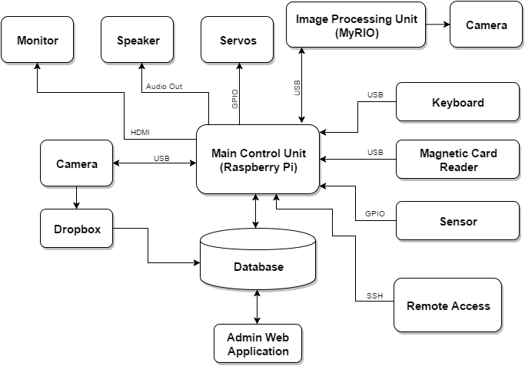
Conceptual Sketch

Slide 6
System Requirements
Users should able to open the tool machine using their card or by entering their ID number with numpad.
The camera for Main Control Unit should able to record 480p video for more than 3 minutes
The camera for Image Processing Unit should able to capture 1080p image for image analysis
The Image Processing Unit able to detect which tool is taken or returned at more than 80% accuracy.
The Dropbox have enough storage to store videos for 1 week worth of videos (assuming the number of tool transaction per day is at most 20)
which is 21 GB
The validation process from MySQL database take less than 2 second.
The tool box must be physically locked.

Slide 7
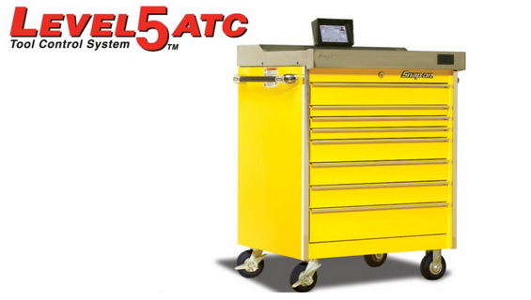
Market Survey
Snap On Level 5 ATC Tool Control System is the best example of product existed in the market.
Using the Level 5 ATC as an example, we will be creating a same functioning system for our project. The goal is to provide a same functioning system that could be afford by the department to implement on campus.
Notes:
Snap On Level 5 ATC Tool Control System is the best example of product existed in the market. This company might be the only company that produced an automated tool control system. The Level 5 ATC comes with a base dimension of 36” and 54” retailed at a price of $21,000 and $26,000 respectively.
Using the Level 5 ATC as an example, we will be creating a same functioning system for our project. The goal is to provide a same functioning system that could be afford by the department to implement on campus. However, we will be delivering a similar functioning system with highest precision as possible that we could at a lower price.

Slide 8
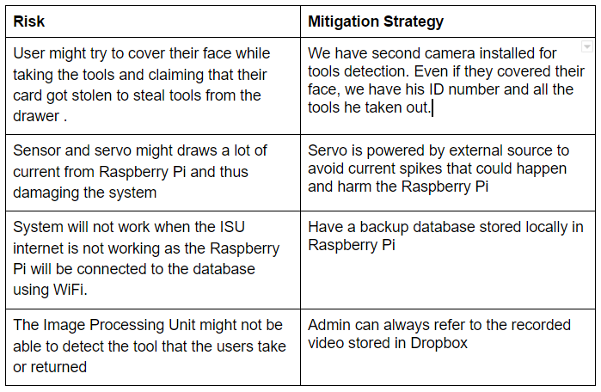
Risk & Mitigation

Slide 9
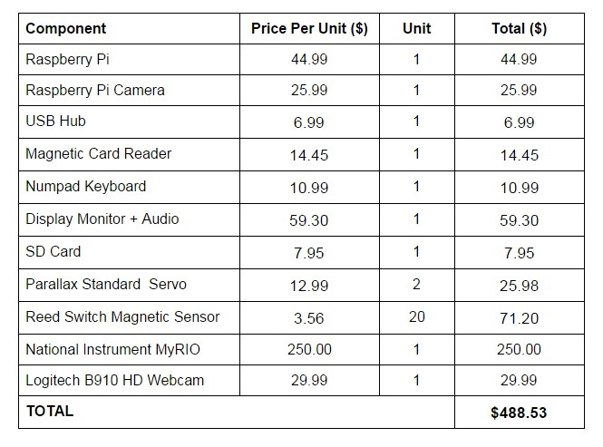
Resource/Cost

Slide 10
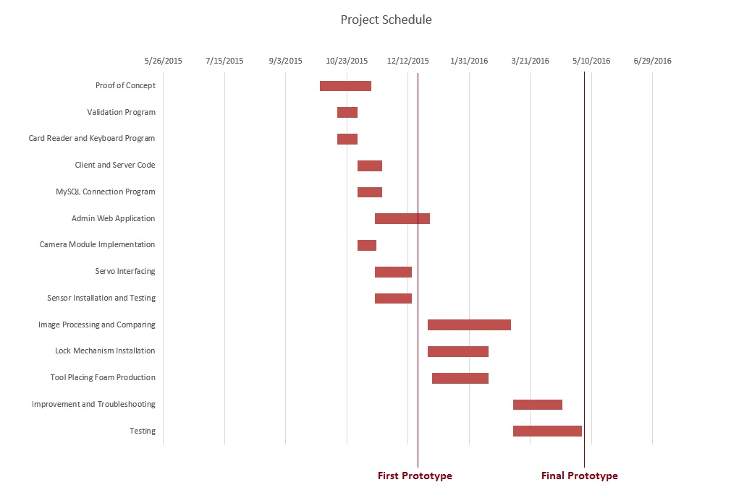
Project Milestones

Slide 11
Functional Decomposition
Authorization
Read ID from the user
Validate the ID with database
Record Video
Activate the camera
Record video
Upload to Dropbox
Unlock Tool Box
Signal the servo
Unlock the key
Detect Missing Tools
Capture Images
Send to Image Processing Unit
Send data back to Main Control Unit
Notes:
FUNCTIONAL DECOMPOSITION
So I’ll talk about the functional decomposition of our system
First we have the authorization where the the system would read the ID from the user and validate with the database
Once the user has been authorized by the system,
the servo will be activated and unlock the tool box
And at the same time the camera will also be activated and starts recording.
After the user swipes their ID again to logout from the system, the camera will stop recording and the video will be uploaded automatically to the dropbox
The servos will moves once again and lock the tool box
Then our system will send the details of the activity to the server and the server will create a new record in the database.

Slide 12
Functional Decomposition...cont’d
Web Application
Monitor users activity
Add new user
Remove user
Monitor transaction history
See tools availability
Notes:
Administration
And the last part of our system functional decomposition is the administration. Which is mainly through our web application
Through this web application, admin would be able to monitor all the users activity and transactions history.
The admin also able to add or remove new user into the database using this web app.
And we also can see the real time availability of the tools in the Tool Box.

Slide 13
Detailed Design
The system is divided into three main parts
Main Control Unit (MCU)
Image Processing Unit (IPU)
Web Application
Notes:
DETAILED DESIGN
So as we mentioned before, our system consist of three main parts
which are the Main Control Unit, The Image Processing Unit, and the Web Application

Slide 14
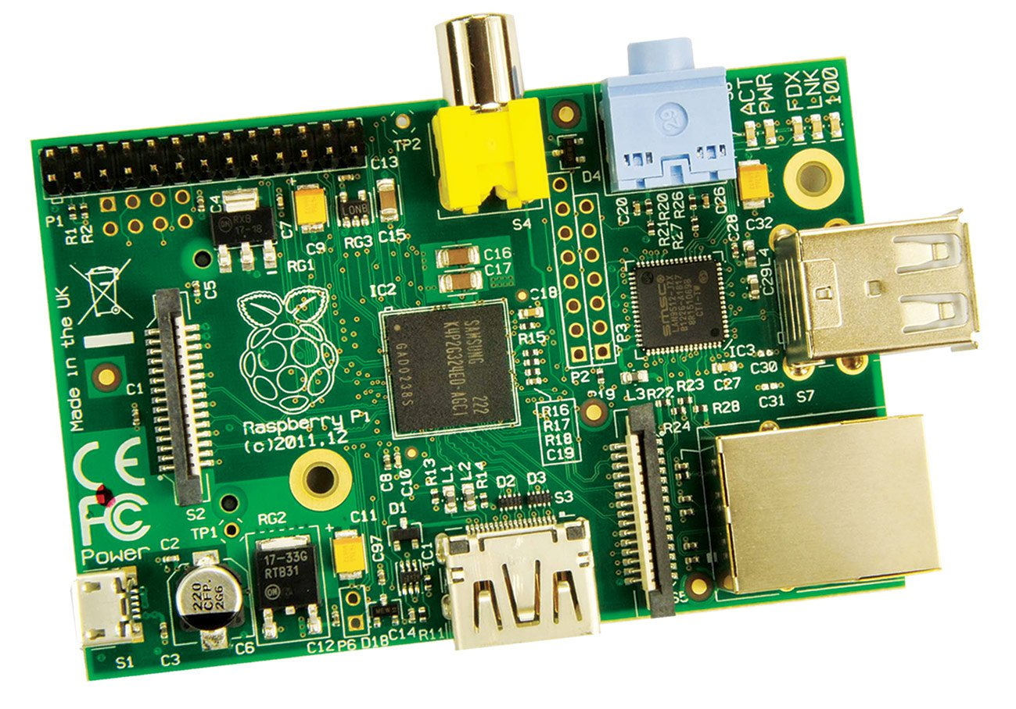
Main Control Unit
Main.py
Handle User Input
Activate the webcam
Upload video to dropbox
Create new record for database
Interface with Image Processing Unit
Servo.py
Interface with servos
Sensor.py
Interface with sensors
Notes:
So for the main control unit, we use the raspberry pi as the platform
The main control Unit will handle all the interaction between the users and the system through this Main.python program.
This main program also will do other stuff like
validating the ID with the database
Activating the Camera
Interacting with the Image Processing Unit
Creating new record to be send to database
And additionally we also have other python script to interface with the sensor and servo

Slide 15
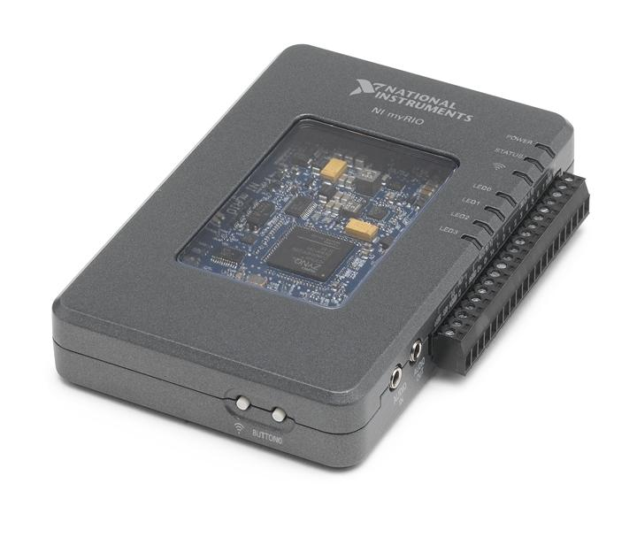
Image Processing Unit
Used to implement the Tools
Detection functionality
This is achieved by creating a
image analysis program using
Vision Assistant script and LabView
Notes:
As we mentioned before, the final product of our system should be able to detect the tool that is removed or returned by user.
This is achieved by creating an image analysis program using Vision Assistant Script and LabView
And then we will deploy the program into MyRIO
Vision Assistant is a National Instrument software that is specialize in creating a script for image processing and analysis program
Meanwhile LabView is also a NI software that is used to deploy a program into MyRIO.

Slide 16
Image Processing Unit… cont’d
Vision Assistant
Color Pattern Matching
Circular Pattern Search
Notes:
So in Vision Assistant Script,
we used two functionality that already built in the vision
to detect which tools is missing from the drawer.
Color Pattern Matching -
We give it a template that is going to be used to compare with our image
and it will return the position where it find the similar color pattern

Slide 17
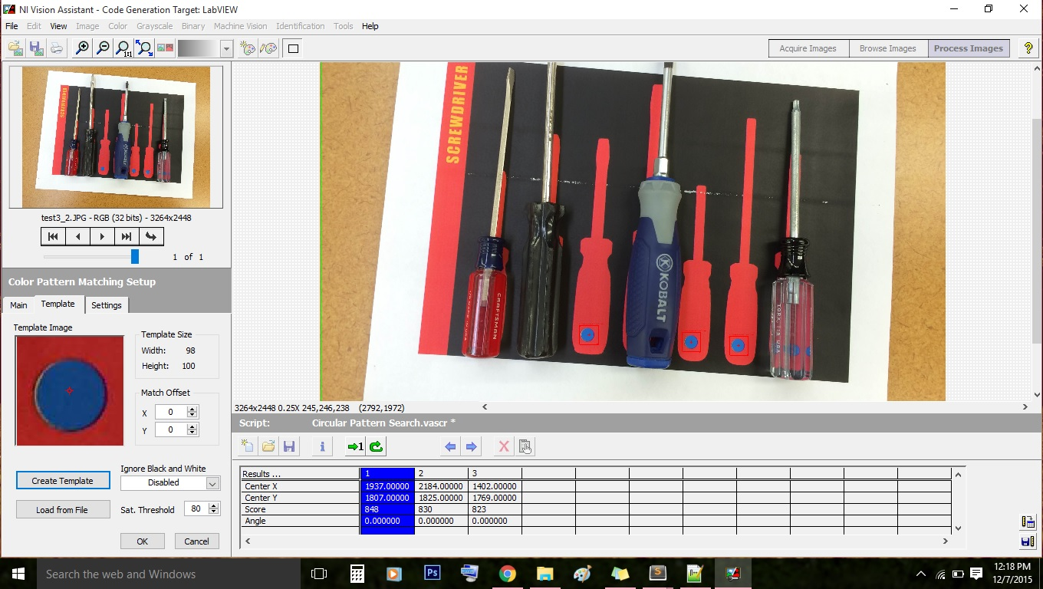
Color Pattern Matching
Notes:
In Color Pattern Matching , We give a template and the program will search for the occurrence of the similar pattern in the given image
And it will return the x and y position of where it find each of the occurrence in the given image.

Slide 18
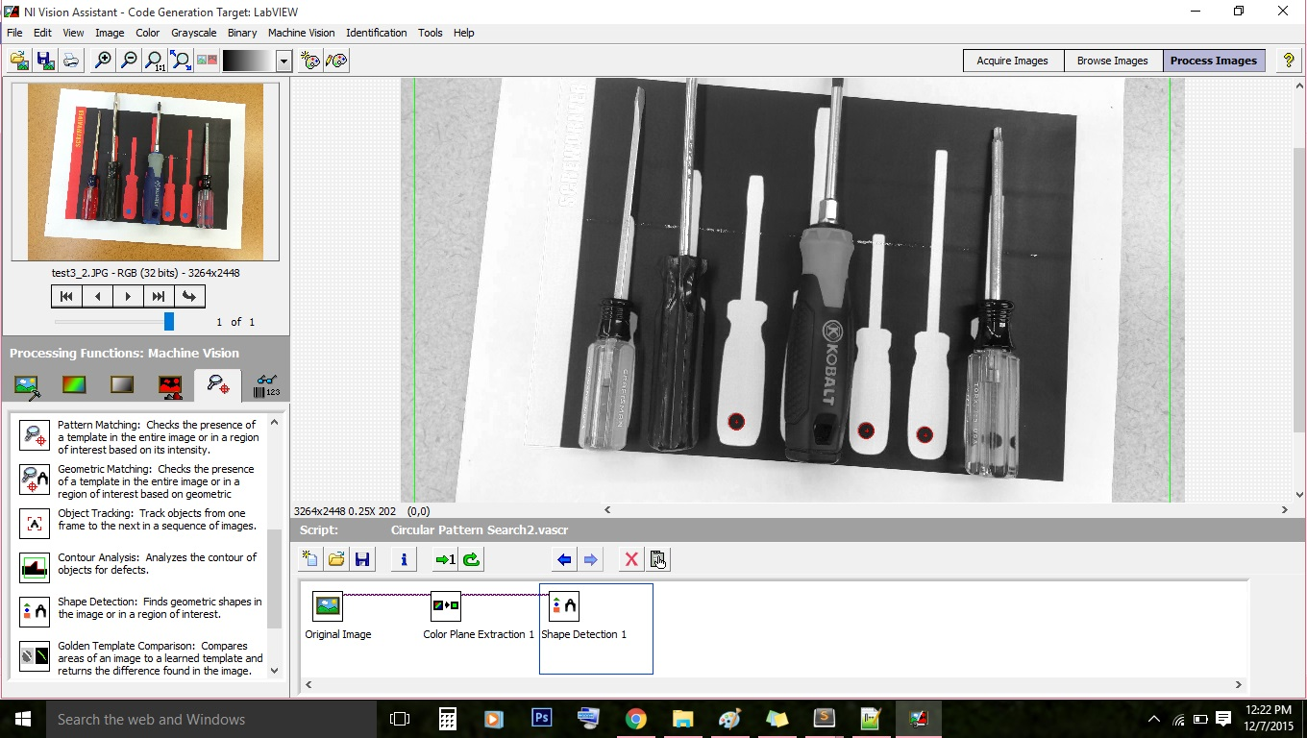
Circular Pattern Search
Notes:
And to get a more accurate result, we will also use
Circular Pattern Search - where we detect circular shape in our image and it will return the location and the radius of the circles.
So by using these vision script. We are able to pin-point the x and y position of where this special circle pattern is found in the image
This data will be send to the Main Control Unit for further analysis so that we can determine which tools is missing from our Tool Box.

Slide 19
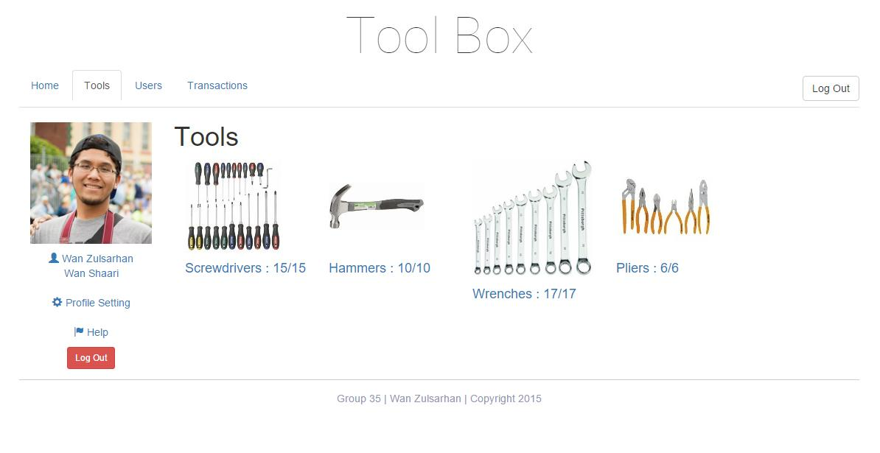
Web Application
Admin Privilege
Monitor all users
Monitor transaction history
See tools availability
Regular User
See tools availability
Notes:
The last part of the system is the web app
As of right now, admin would be able to monitor all users and transaction history
using our web application
and regular user or guest also can use our web app to see the tool availability in the ToolBox

Slide 20
Web Application
Client Side
Using Laravel 5 framework
HTML, CSS and Blade Templating Engine
Server Side
PHP scripting language
MySQL database
Dropbox (to store video)
Notes:
The last part of the system is the web app
For the client side of the app, we use Laravel 5 as the framework which make used of HTML, CSS and Blade Templating Engine
*Blade is one of Lavarel special features that make it easier to put PHP code HTML document.
*its part of the framework
As for the server side. we mainly use PHP to handle all the interaction with our mySQL database
And as mentioned before, we store our recorded video in Dropbox cloud storage.

Slide 21
Platform Used
HARDWARE
Raspberry Pi
NI MyRIO
SOFTWARE
Python
PHP
Laravel Framework
LabView
Vision Assistant
Notes:
So these are the list of platform that we used in our project

Slide 22
Testing Plan
Hardware
Test to verify Raspberry Pi, servo, camera, magnetic card reader and keyboard can perform under modest stress condition
Electronics
Simulate sensor and servo circuit
Software
Test all edge cases in the Main program
Conduct a usability testing for web application with our client

Slide 23
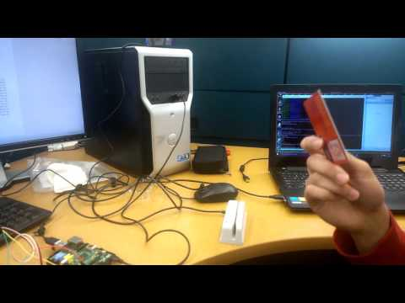
Prototype Implementation
First Prototype Demonstration

Slide 24
Current Project Status
Main Control Unit ✔
Admin Web Application ✔
Image Processing Unit (On Going)
Lock Mechanism (Next Semester)
Tool Box Setup (Next Semester)
Notes:
Image Processing Unit
-we need to create a LabView program to deploy the image analysis program into MyRIO
-and implement a communication protocol between MyRIO and Raspberry Pi
Lock Mechanism
- we need to work on integrating the servo to the existing lock of the tool box
- which will involve some mechanical stuff
Tool Box Setup
-Will also need to produce foams with that circle shape to place tools in each of the drawers

Slide 25
Plan for Next Semester
Work on the lock mechanism
Set up the tool box
Continue to work on the Image Processing Unit
Add more functionality to the Web Application
Add and Remove User
Send notification to User
Work on the sensors circuit design for the drawers
Testing and Improvement

Slide 26
Questions?
?

